Slide 1
Binary Search Trees
Julien Nyambal

Slide 2
Linear data structures

Slide 3
Where are we coming from? Linear data structures
Arrays
Linked Lists
Stacks
Queues
5 | 6 | 8 | 7 | 2 | 5 | 5 | 7
5
6
7
8

Slide 4
Where are we coming from? Linear data structures
They have in common a start and end
They are arranged in a sequential manner
But depending on what you need to do, you are bound to some constraints:
The data that needs to be stored on memory: sorted? Searchable?
What does it cost us to manipulate that stores data? Remember time complexity?
How much memory do we need to store and manipulate the data?
How easy it is to implement a quick solution?

Slide 5
Drawback of the linear data structures …
1 - Arrays
If the data is sorted inserting in an array, then insertion, deletion, and lookups (searches) are fast.
But, if the array is large, deleting from an array is time consuming, O(n), with al the data shifting.
2 - Linked Lists
Deleting and inserting from Linked Lists are faster than the array
But, the problem with the linked lists happen with the search of the element to delete or the place to insert an item.
3 – Most importantly, the above structure cannot keep a hierarchical structure in the data. That’s why we need trees.

Slide 6
Trees

Slide 7
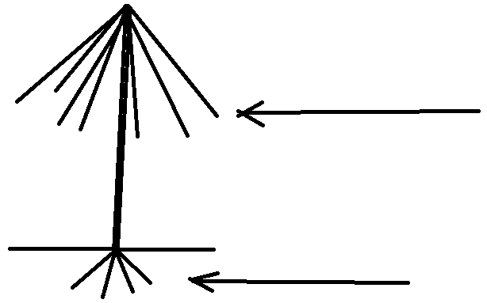

What is a tree ?
Apples
roots

Slide 8

What is a tree ?
From the previous lecture on graphs:
Tree = Set of Vertices + Set of edges + Root (without “s”)
Does not contain cycles (acyclic)
This Photo by Unknown Author is licensed under CC BY-NC-ND
Tree
Not aTree

Slide 9
What is a tree ?
Root Node
Parent Node (Child to the
root node)
Child node
This Photo by Unknown Author is licensed under CC BY-NC-ND
Leaf node

Slide 10
What is a tree ?
Properties:
Let a tree T:
T has N nodes
T has at most N-1 edges
Let a node X
The depth or level of X is length of the path (Number of edges) form the root node to X
The height of X is the length of the path from node X to the leaf
Level root = 0
Height root = 3
Level child node = 1
Level leaves = 3
Height leaves = 3

Slide 11
Binary Trees

Slide 12
Binary trees: Applications
Machine Learning Decision trees: This basically rules most of enterprises decision making from car or home loans, to visa acceptance or rejection (Canada) within the form of questionnaires (yes/no …)
Compiler Syntax Checking: Syntax Tree - Constructed by compilers and (implicitly) calculators to parse expressions.
Playground: https://visualgo.net/bn/bst

Slide 13
What is a binary tree ?
Definition: A binary tree, T, is either empty or such that
i. T has a special node called the root node.
ii. T has two sets of nodes, LT and RT, called the left subtree and right subtree of T, respectively.
iii. LT and RT are binary trees.
The node arrangement is not ordered
Binary Tree
Not a Binary Tree

Slide 14
What is a binary tree ?
Properties:
A binary tree can have most 2 edges.
A 1 node tree is also a binary tree
A Full binary tree is when each node has either 0 or 2 children, per level
A Complete binary tree is when all the nodes (except possibly the leaves) are filed with children nodes, and all nodes are as far left as possible
A perfect binary tree is when every node is full or have 2 nodes equally at all levels
The level of a binary tree is similar it depth
Let’s assume the level of a tree T being i. The total number of nodes per level is 2^{i}
Let’s assume the height of a tree being h. The total number of nodes in Tis 2^{h+1} – 1
^{Try that one out!!}

Slide 15
What is a binary tree ?
^{Types of binary trees:}
5
5
5
5
2
5
2
5
2
3
2
3
3
2
3
2
Not Full tree
Full tree
Perfect tree
5
5
5
2
5
2
3
2
3
2
2
Complete tree
Complete tree

Slide 16
What is a binary tree ?
5
5
2
Does Complete == Full? No
Does Full == Complete? No
Perfect == Complete + Full
3
2
2
Complete tree but not Full
5
Very important: Not complete because needs to be filed as far left as possible first.
5
2
2
2
3

Slide 17
What is a binary tree ?
 | 5
5
 | 3
 | 2
3
2
2
 | 2
 | 3
3
2
6
7
4
 | 2
 | 6
 | 7
 | 4
Technically a tree looks like this, and its implementation to the right. As you can see this implemented using a doubly linked list.
Struct Link {
int data;
Link *left;
Link *right;
}

Slide 18
Binary Search Trees aka BST

Slide 19
What is a binary search tree ?
Definition: A binary search tree, T, is either empty or the following is true:
T has a special node called the root node.
T has two sets of nodes, left tree and right tree, called the left subtree and right subtree of T, respectively.
The key in the root node is larger than every key in the left subtree and smaller than every key in the right subtree. ← Very Important!!
left tree and right tree are binary search trees.

Slide 20
What is a binary search tree ?
5
8
3
2
7
9
2
3
5
13
2
6
7
4
3
6
12
14
Not a binary search tree
Binary search tree

Slide 21
What is a binary search tree ?
Operations on a BST
Search the binary search tree for a particular item.
Insert an item in the binary search tree.
Delete an item from the binary search tree.
Find the height of the binary search tree.
Find the number of nodes in the binary search tree.
Find the number of leaves in the binary search tree.
Traverse the binary search tree.

Slide 22
Binary Search Trees: The numbers

Slide 23
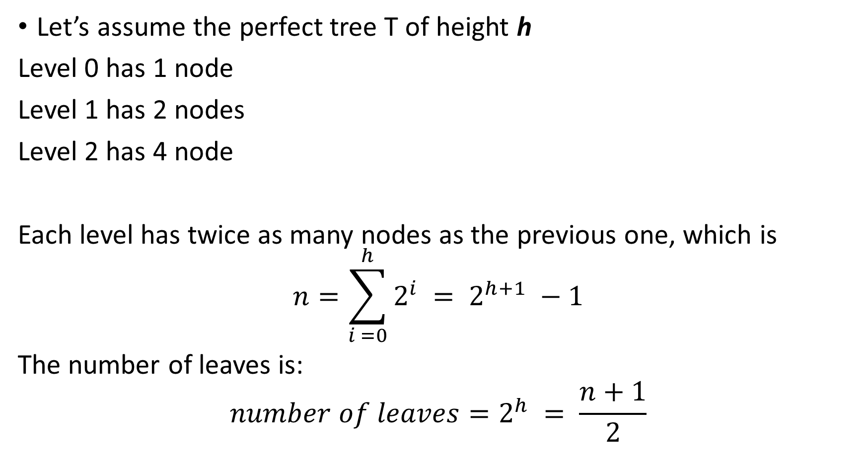
Total Number of Nodes in a BST
5
Level 0
3
2
Level 1
Let’s assume the perfect tree T of height h
Level 0 has 1 node
Level 1 has 2 nodes
Level 2 has 4 node
Each level has twice as many nodes as the previous one, which is
$$n=\sum_{i =0}^{h}{2^{i} = 2^{h+1}} −1$$
The number of leaves is:
$$number of leaves=2^{h} = \frac{n+1}{2}$$
2
6
7
3
Level 2

Slide 24
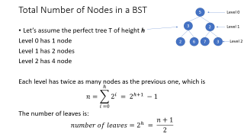
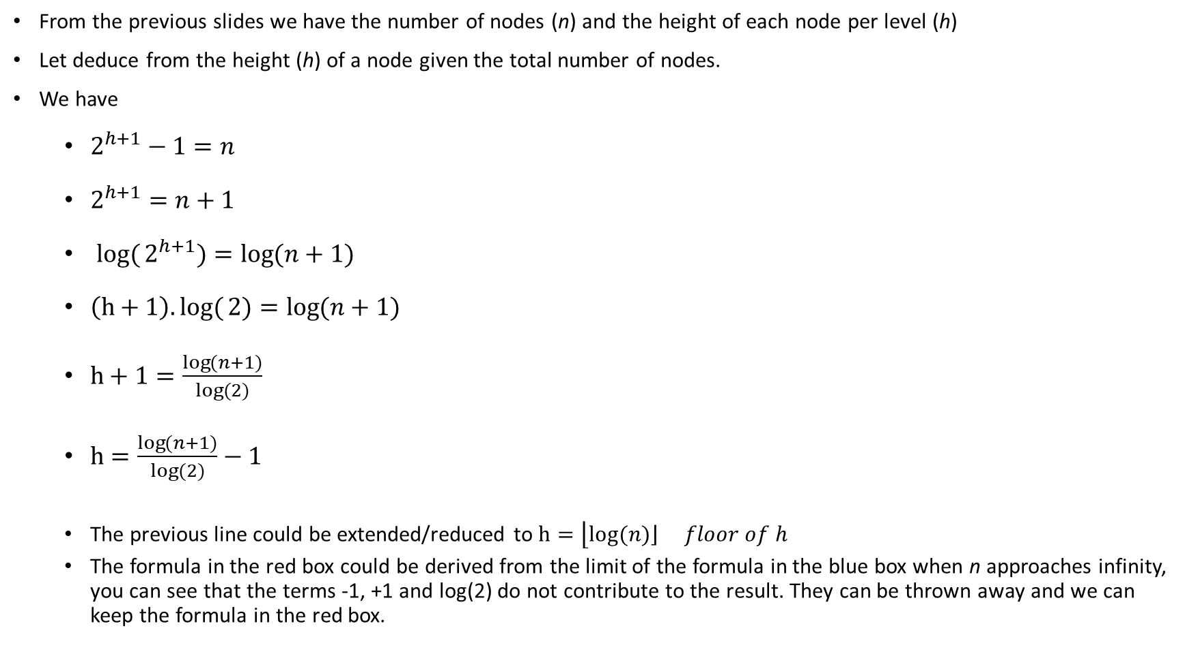
Height of a node in a BST
From the previous slides we have the number of nodes (n) and the height of each node per level (h)
Let deduce from the height (h) of a node given the total number of nodes.
We have
$2^{h+1}−1=n$
$2^{h+1}=n+1$
$log({2^{h+1})}=\log{(n+1)}$
$\left(h+1\right).log({2)}=\log{(n+1)}$
$h+1=\frac{\log{(n+1)}}{log⁡(2)}$
$h=\frac{\log{(n+1)}}{log⁡(2)}−1$
The previous line could be extended/reduced to $h=\left\lfloor log⁡(n)\left\rfloor \right.\right. floor of h$
The formula in the red box could be derived from the limit of the formula in the blue box when n approaches infinity, you can see that the terms -1, +1 and log(2) do not contribute to the result. They can be thrown away and we can keep the formula in the red box.

Slide 25
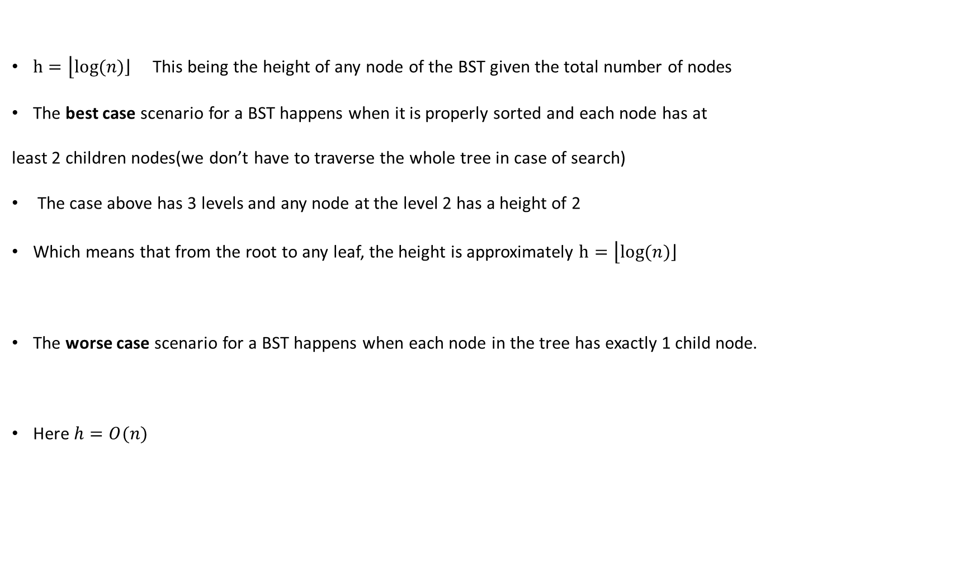
A bit of complexity analysis
5
$h=\left\lfloor log⁡(n)\left\rfloor \right.\right.$This being the height of any node of the BST given the total number of nodes
The best case scenario for a BST happens when it is properly sorted and each node has at
least 2 children nodes(we don’t have to traverse the whole tree in case of search)
The case above has 3 levels and any node at the level 2 has a height of 2
Which means that from the root to any leaf, the height is approximately $h=\left\lfloor log⁡(n)\left\rfloor \right.\right.$
The worse case scenario for a BST happens when each node in the tree has exactly 1 child node.
Here $h=O(n)$
3
2
2
6
7
3
1
2
3
4
5
6

Slide 26
Binary Search Tree Traversals

Slide 27
Binary Search Tree Traversals
When it comes to traversal, there are 2 choices: either we visit the node first or the subtrees first.
The following traversals belong to the depth-first traversal, which is implemented using a stack.
There are 3 sorts of traversals:
In-Order traversal
Pre-Order traversal
Post-Order traversal

Slide 28
Binary Search Tree Traversals
5
In-Order traversal
Traverse the left subtree or print left node
Visit or print the current node
Traverse the right subtree or print right node
Let’s us do the in-order traversal of the tree T
3
6
2
4
7

Slide 29
Binary Search Tree Traversals
5
In-Order traversal
Stack (left first, no choice on this): 5,3,2
We traverse as left as we can, the we print the we go right
Remember that stuff are in a stack
2 is at the top of the stack.
Print 2, the we are at 3, print 3, go right, then print left of 4 then print 4 …
Result: 2,3,4,5,6,7
3
6
2
4
7

Slide 30
Binary Search Tree Traversals
5
Pre-Order-Order traversal
Visit or print the current node
Traverse the left subtree or print left node
Traverse the right subtree or print right node
Let’s us do the pre-order traversal of the tree T
3
6
2
4
7

Slide 31
Binary Search Tree Traversals
5
Pre-Order traversal
This is you typical Depth First Search
Result: 5,3,2,4,6,7
3
6
2
4
7

Slide 32
Binary Search Tree Traversals
5
Post-Order traversal
Traverse the left subtree or print left node
Traverse the right subtree or print right node
Visit or print the current node
Let’s us do the post-order traversal of the tree T
Result: 2,4,3,7,6,5
3
6
2
4
7

Slide 33
Binary Search Tree Traversals
Little trick Regardless the traversal:
On top of each node, depending on the traversal,
put the order of the traversal: IOT = LPR, PostOT = LRP, PreOT = RLP
Where L = Left, R = Right, P = Print
For each node traversed ,cross the first letter and go as left as you can. Cross the very last letter if you do not have any other choice and go one level up.

Slide 34
Binary Search Tree Traversals
IOT = LPR, PostOT = LRP, PreOT = RLP
Where L = Left, R = Right, P = Print. We are doing In Order Traversal
Expected Result: 2,3,4,5,6,7
Result:
LPR
5
LPR
3
6
LPR
LPR
LPR
LPR
2
4
7

Slide 35
Binary Search Tree Traversals
IOT = LPR, PostOT = LRP, PreOT = RLP
Where L = Left, R = Right, P = Print. We are doing In Order Traversal
Expected Result: 2,3,4,5,6,7
Result:
LPR
left
5
LPR
3
6
LPR
LPR
LPR
LPR
2
4
7

Slide 36
Binary Search Tree Traversals
IOT = LPR, PostOT = LRP, PreOT = RLP
Where L = Left, R = Right, P = Print. We are doing In Order Traversal
Expected Result: 2,3,4,5,6,7
Result:
LPR
LPR
5
left
LPR
3
6
LPR
LPR
LPR
LPR
2
4
7

Slide 37
Binary Search Tree Traversals
IOT = LPR, PostOT = LRP, PreOT = RLP
Where L = Left, R = Right, P = Print. We are doing In Order Traversal
Expected Result: 2,3,4,5,6,7
Result:
LPR
LPR
5
LPR
LPR
3
6
LPR
LPR
LPR
left
LPR
2
4
7

Slide 38
Binary Search Tree Traversals
IOT = LPR, PostOT = LRP, PreOT = RLP
Where L = Left, R = Right, P = Print. We are doing In Order Traversal
Expected Result: 2,3,4,5,6,7
Result: 2,
LPR
LPR
5
LPR
LPR
3
6
LPR
LPR
LPR
print
LPR
LPR
2
4
7

Slide 39
Binary Search Tree Traversals
IOT = LPR, PostOT = LRP, PreOT = RLP
Where L = Left, R = Right, P = Print. We are doing In Order Traversal
Expected Result: 2,3,4,5,6,7
Result: 2,
LPR
LPR
5
LPR
LPR
3
6
LPR
LPR
LPR
right
LPR
LPR
2
4
7

Slide 40
Binary Search Tree Traversals
IOT = LPR, PostOT = LRP, PreOT = RLP
Where L = Left, R = Right, P = Print. We are doing In Order Traversal
Expected Result: 2,3,4,5,6,7
Result: 2,
LPR
LPR
5
LPR
LPR
3
6
LPR
LPR
LPR
right
LPR
LPR
2
4
7

Slide 41
Binary Search Tree Traversals
IOT = LPR, PostOT = LRP, PreOT = RLP
Where L = Left, R = Right, P = Print. We are doing In Order Traversal
Expected Result: 2,3,4,5,6,7
Result: 2,3,
LPR
LPR
5
LPR
print
LPR
3
6
LPR
LPR
LPR
LPR
LPR
2
4
7

Slide 42
Binary Search Tree Traversals
IOT = LPR, PostOT = LRP, PreOT = RLP
Where L = Left, R = Right, P = Print. We are doing In Order Traversal
Expected Result: 2,3,4,5,6,7
Result: 2,3,
LPR
LPR
5
LPR
right
LPR
3
6
LPR
LPR
LPR
LPR
LPR
2
4
7

Slide 43
Binary Search Tree Traversals
IOT = LPR, PostOT = LRP, PreOT = RLP
Where L = Left, R = Right, P = Print. We are doing In Order Traversal
Expected Result: 2,3,4,5,6,7
Result: 2,3,5,
LPR
LPR
print
5
LPR
LPR
3
6
LPR
LPR
LPR
LPR
LPR
2
4
7

Slide 44
Binary Search Tree Traversals
IOT = LPR, PostOT = LRP, PreOT = RLP
Where L = Left, R = Right, P = Print. We are doing In Order Traversal
Expected Result: 2,3,4,5,6,7
Result: 2,3,5,
LPR
LPR
5
LPR
LPR
3
6
LPR
left
LPR
LPR
LPR
LPR
2
4
7

Slide 45
Binary Search Tree Traversals
IOT = LPR, PostOT = LRP, PreOT = RLP
Where L = Left, R = Right, P = Print. We are doing In Order Traversal
Expected Result: 2,3,4,5,6,7
Result: 2,3,5,
LPR
LPR
5
LPR
LPR
3
6
LPR
LPR
LPR
left
LPR
LPR
2
4
7

Slide 46
Binary Search Tree Traversals
IOT = LPR, PostOT = LRP, PreOT = RLP
Where L = Left, R = Right, P = Print. We are doing In Order Traversal
Expected Result: 2,3,4,5,6,7
Result: 2,3,5,
The position of the 7 is a mistake. Why???? Did you understand the trick?
LPR
LPR
5
LPR
LPR
3
6
LPR
LPR
LPR
left
LPR
LPR
2
4
7

Slide 47
Searching in a Binary Search Tree

Slide 48
Searching in a Binary Search Tree
This happens to be the simplest operation
From the definition of a BST, the left subtree of each node contains element less than current node, otherwise, it is in the right subtree.

Slide 49
Searching in a Binary Search Tree
Let’s assume that we are searching for the value 12 from the tree below
8
7
9
5
13
3
6
12
14

Slide 50
Searching in a Binary Search Tree
Let’s assume that we are searching for the value 12
8
Is the current node 12? No.
We have 8, which is less than 12. So 12 should be on the right of 8.
7
9
5
13
3
6
12
14

Slide 51
Searching in a Binary Search Tree
Let’s assume that we are searching for the value 12
8
Is the current node 12? No.
We have 9, which is less than 12. So 12 should be on the right of 9.
7
9
5
13
3
6
12
14

Slide 52
Searching in a Binary Search Tree
Let’s assume that we are searching for the value 12
8
Is the current node 12? No.
We have 13, which is greater than 12. So 12 should be on the left of 13.
7
9
5
13
3
6
12
14

Slide 53
Searching in a Binary Search Tree
Let’s assume that we are searching for the value 12
8
Is the current node 12? Yes.
stop
7
9
5
13
3
6
12
14
We have to note that the Max item is at the far right of the tree.
The Min item is at the fart left of the tree.

Slide 54
Inserting in a Binary Search Tree

Slide 55
Inserting in a Binary Search Tree
Inserting is slightly similar to searching. Same principles
Let’s assume that we want to insert 1 (easy)
1
8
Current node 8 (8 > 1): Go left
7
9
5
13
3
6
12
14

Slide 56
Inserting in a Binary Search Tree
Inserting is slightly similar to searching. Same principles
Let’s assume that we want to insert 1 (easy)
1
8
Current node 8 (8 > 1): Go left
Current node 7 (7 > 1): Go left
7
9
5
13
3
6
12
14

Slide 57
Inserting in a Binary Search Tree
Inserting is slightly similar to searching. Same principles
Let’s assume that we want to insert 1 (easy)
1
8
Current node 8 (8 > 1): Go left
Current node 7 (7 > 1): Go left
Current node 5 (5 > 1): Go left
7
9
5
13
3
6
12
14

Slide 58
Inserting in a Binary Search Tree
Inserting is slightly similar to searching. Same principles
Let’s assume that we want to insert 1 (easy)
1
8
Current node 8 (8 > 1): Go left
Current node 7 (7 > 1): Go left
Current node 5 (5 > 1): Go left
Current node 3 (3 > 1): Go left
7
9
5
13
3
6
12
14

Slide 59
Inserting in a Binary Search Tree
Inserting is slightly similar to searching. Same principles
Let’s assume that we want to insert 1 (easy)
8
Current node 8 (8 > 1): Go left
Current node 7 (7 > 1): Go left
Current node 5 (5 > 1): Go left
Current node 3 (3 > 1): Go left
Nothing there the insert
7
9
1
5
13
3
6
12
14
1

Slide 60
Inserting in a Binary Search Tree
From the previous tree insert 4,10,100, as an exercise to do now on a sheet of paper with all the steps …
8
7
9
5
13
3
6
12
14

Slide 61
Deleting an item from a Binary Search Tree

Slide 62
Deleting an item from a Binary Search Tree
This is the trickiest of all. Remember that, the properties stated above about the BST should be preserved. There are 3 cases:
Deleting a leaf node (easy)
Deleting a node that has 1 child (kinda hard)
Deleting a node that has 2 children (brace yourself)

Slide 63
Deleting an item from a Binary Search Tree
8
Case 1: Deleting a leaf node
Let’s assume the previous tree T
We want to delete the node
We traverse T until the parent of the target
Delete
Set ‘s right pointer to point to NULL
7
9
5
13
12
3
6
12
14
13
12
13

Slide 64
Deleting an item from a Binary Search Tree
8
Case 2: Deleting a node that has 1 child
Let’s assume the previous tree T
We want to delete the node
We traverse T until the parent of the target
Set the relevant child pointer of (left or right) to point to ‘s child ( )
Delete (Remember to keep a tmp pointer)
7
9
3
13
5
12
14
7
7
5
3
5

Slide 65
Deleting an item from a Binary Search Tree
50
Case 3: Deleting a node that has 2 children
Let’s assume the previous tree T
We want to delete 50 (or node N)
We have bring this case down to case 2, that is where there is not right of left subtree
We need to find the immediate inorder successor of N.
This is done by taking the right subtree, then go as far left possible (this is a finite set, we will always reach the last left), that would be the immediate successor of N which is in this case 51
Swap N with its successor, and delete N as per case 2
30
90
25
41
55
95
12
28
39
47
51
7

Slide 66
Deleting an item from a Binary Search Tree
We want to delete this one
50
30
90
25
41
55
95
12
28
39
47
51
7

Slide 67
Deleting an item from a Binary Search Tree
We go to the right subtree of 50
50
30
90
25
41
55
95
12
28
39
47
51
7

Slide 68
Deleting an item from a Binary Search Tree
50
30
90
25
41
55
95
12
28
39
47
51
7

Slide 69
Deleting an item from a Binary Search Tree
50
30
90
25
41
55
95
12
28
39
47
51
7

Slide 70
Deleting an item from a Binary Search Tree
50
30
90
25
41
55
95
12
28
39
47
51
7
No left subtree, so indeed 51 is the immediate successor of 50

Slide 71
Deleting an item from a Binary Search Tree
50
30
90
25
41
55
95
12
28
39
47
51
7
No left subtree, so indeed 51 is the immediate successor of 50

Slide 72
Deleting an item from a Binary Search Tree
50
30
90
25
41
55
95
12
28
39
47
51
7
No left subtree, so indeed 51 is the immediate successor of 50

Slide 73
Deleting an item from a Binary Search Tree
50
Swap the 51 with 50
Swap the 50 with 51
30
90
25
41
55
95
12
28
39
47
51
7
No left subtree, so indeed 51 is the immediate successor of 50

Slide 74
Deleting an item from a Binary Search Tree
51
30
90
25
41
55
95
12
28
39
47
50
7

Slide 75
Deleting an item from a Binary Search Tree
51
Peacefully delete 50
30
90
25
41
55
95
12
28
39
47
50
7

Slide 76
Deleting an item from a Binary Search Tree
51
30
90
25
41
55
95
12
28
39
47
7

Slide 77
End

